Slide 1

Analytical and preparative supercritical fluid chromatography (SFC):
How green can it be?
Caroline West
Université d’Orléans, ICOA, CNRS UMR 7311
SŌSHI Center
(Shimadzu Orléans University Supercritical fluids Innovations Centre)

Slide 2
01
Fluids & instruments for SFC
02
What is green about SFC?
03
OUTLINE
Greener processes with online SFE-SFC

Slide 3
Fluids &
Instruments for SFC

Slide 4


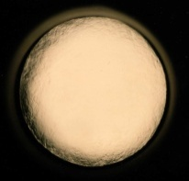
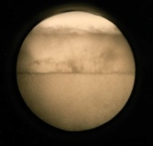
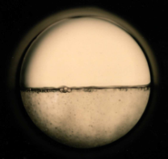

Fluid state
State diagram for CO₂
Pressure
(MPa)
14
Liquid
Supercritical fluid
13
12
11
C. West, The Green Analytical Chemistry Workshop, Feb. 2nd, 2026
10
9
Critical point
8
*
7
31°C
7.3 MPa
Liquid/gas
Gas
6
Temperature (°C)
20
30
40
50
60
70
‹#›

Slide 5
Fluid density
Isodensity lines in pure CO₂
Pressure
(MPa)
Liquid
Supercritical fluid
20
1.0
0.60
Highly compressible!
Large range of densities:
ρ = 0.15-0.90
0.90
0.65
0.50
0.80
0.55
0.95
0.70
0.85
0.45
0.40
Supercritical fluid
0.75
15
0.35
0.30
C. West, The Green Analytical Chemistry Workshop, Feb. 2nd, 2026
0.25
Critical point
10
0.20
*
*
0.15
0.10
Liquid/gas
5
Gas
0.05
Temperature (°C)
25
45
65
85
‹#›
Adapté de A.Tarafder, G. Guiochon, J. Chromatogr. A 126 (2012) 165

Slide 6


Why CO₂?
Critical point is easy to reach
= favorable to low energy consumption
Non flammable
Low reactivity, not corrosive
Low toxicity (GRAS)
Recyclable
Available in large amounts
at different levels of purity
Cheap
Low polarity
but
Excellent miscibility to most organic solvents
C. West, The Green Analytical Chemistry Workshop, Feb. 2nd, 2026
$
$
$
$
$
$
‹#›

Slide 7
Operating parameters
25-60°C
Temperature
100-200 bar
Pressure
Co-solvent
2-50%
MeOH, EtOH, iPrOH…
C. West, The Green Analytical Chemistry Workshop, Feb. 2nd, 2026
Solubility
3 factors to optimize solubility
‹#›

Slide 8
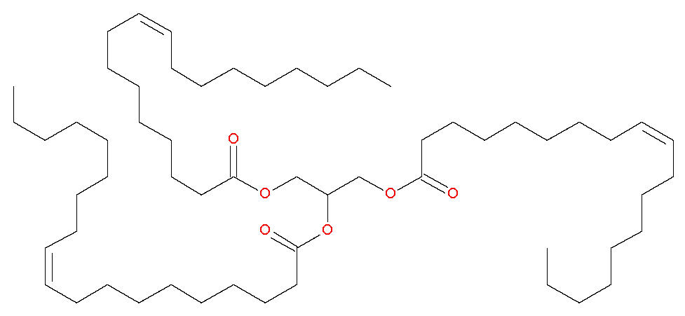
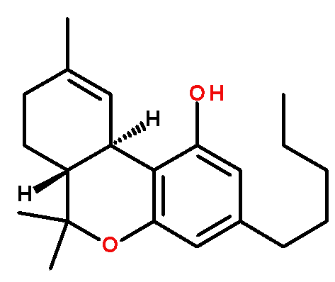
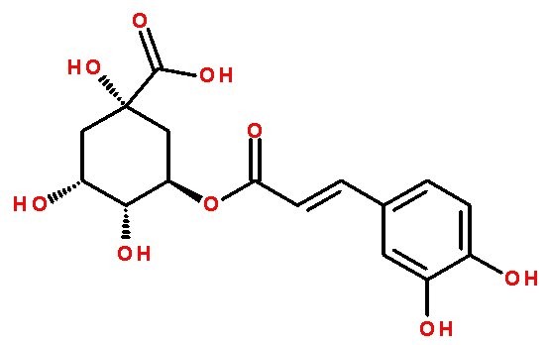
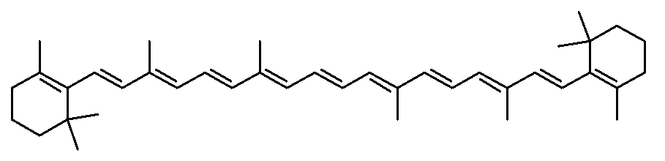
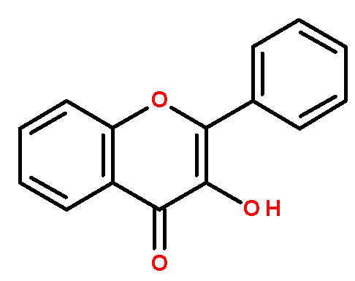
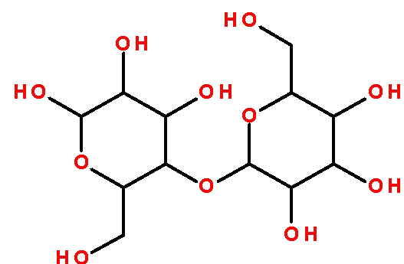
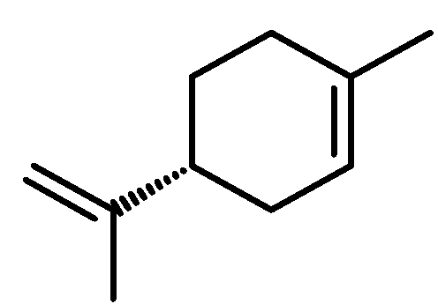
Polarity of CO₂-solvent mixtures
Lipids
Cannabinoids
Sugars
Polyphenols
C. West, The Green Analytical Chemistry Workshop, Feb. 2nd, 2026
Terpenes
Elution strength / Polarity
CO₂
…increasing density (P,T)…
+ co-solvent + H₂O
‹#›
See also T. Lefèbvre et al., J. Chromatogr. A 1635 (2021) 461770

Slide 9
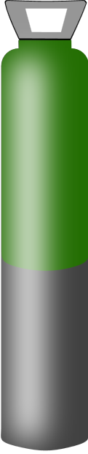



SFC Instruments
Sample introduction
Make-up fluid
pump
Column oven
CO₂ pump
Diode-array
detector
Mass Spectrometer
C. West, The Green Analytical Chemistry Workshop, Feb. 2nd, 2026
CO₂
Solvent
pump
Packed columns
Back-pressure regulator (BPR)
Gaseous
CO₂
Organic
co-solvent
Liquid
co-solvent
Fraction collector
‹#›

Slide 10
What is green
about SFC?

Slide 11
How to compare methods fairly?
Most often observed: comparison based on liquid solvent volumes (excluding CO₂)
Pre-requisite to a fair comparison :
Compare only optimized methods
Compare methods based on identical scales and column dimensions
e.g. prep-HPLC/prep SFC ; HPLC/SFC; UHPLC/UHPSFC
Consider all chemicals included in the separation
e.g. solvents, additives, make-up fluids for prep or MS detection…
C. West, The Green Analytical Chemistry Workshop, Feb. 2nd, 2026
Energy consumption must also be considered
Solvent economy is also related to energy economy at prep scale
‹#›

Slide 12
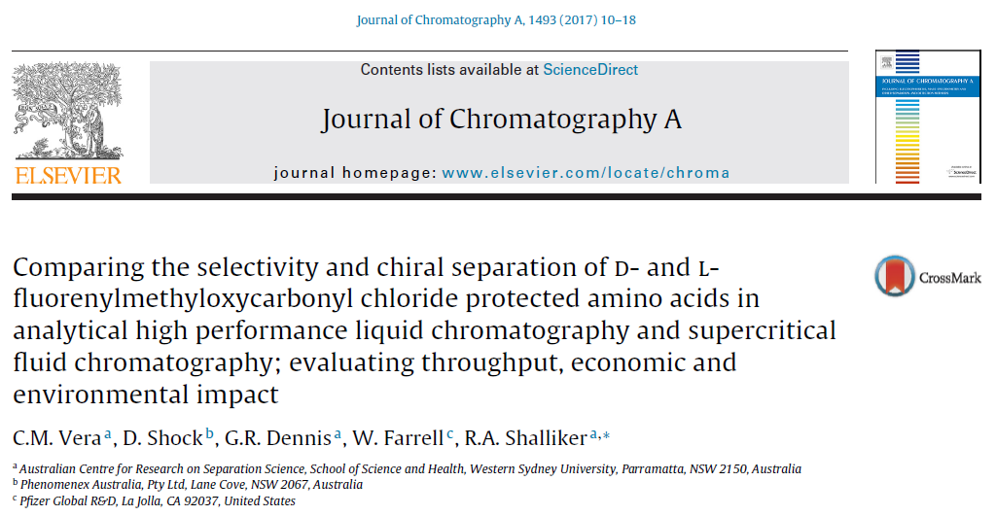
A case study
C. West, The Green Analytical Chemistry Workshop, Feb. 2nd, 2026
3 methods compared: NPLC, RPLC and SFC
Identical column dimensions for all (250 x 4.6 mm, 3 µm)
‹#›

Slide 13
A case study
Analysis
Time (min)
NPLC
1 mL/min
Relevant for energy economy
C. West, The Green Analytical Chemistry Workshop, Feb. 2nd, 2026
RPLC
1 mL/min
SFC
3 mL/min
‹#›

Slide 14
A case study
Liquid solvent
volume (mL)
NPLC
1 mL/min
HPT-iPrOH-FA
80:20:0.1
Relevant for solvent and energy economy at preparative scale
C. West, The Green Analytical Chemistry Workshop, Feb. 2nd, 2026
RPLC
1 mL/min
H₂O-ACN-FA
30:70:0.1
SFC
3 mL/min
CO₂-MeOH-FA
60:40:0.1
‹#›

Slide 15
How to compare methods fairly?
Most often observed: comparison based on liquid solvent volumes (excluding CO₂)
Pre-requisite to a fair comparison :
Compare only optimized methods
Compare methods based on identical scales and column dimensions
e.g. prep-HPLC/prep SFC ; HPLC/SFC; UHPLC/UHPSFC
Consider all chemicals included in the separation
e.g. solvents, additives, make-up fluids for prep or MS detection…
C. West, The Green Analytical Chemistry Workshop, Feb. 2nd, 2026
Energy consumption must also be considered
Can we really pretend that CO₂ has no impact ?
‹#›

Slide 16
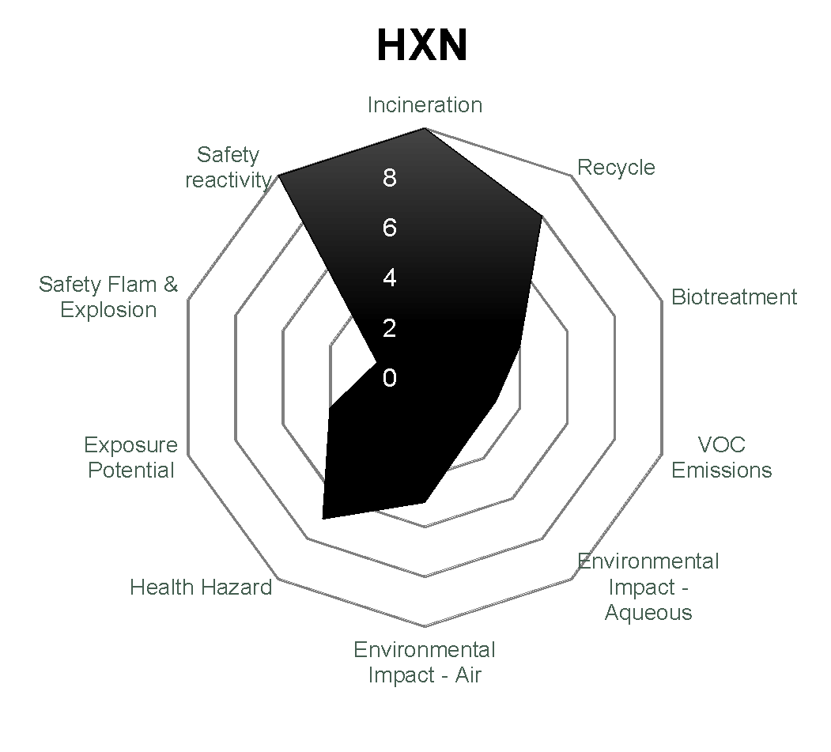
GSK solvent sustainability guide
Score /10
For 10 criteria
C. West, The Green Analytical Chemistry Workshop, Feb. 2nd, 2026
Small surface
= poor green performance
‹#›
C.M. Alder et al., Green Chem. 18 (2016) 3879

Slide 17

GSK solvent sustainability guide
Safety
Waste
Does not take account of solvent production
C. West, The Green Analytical Chemistry Workshop, Feb. 2nd, 2026
Health
Small surface
= poor green performance
Environment
‹#›
C.M. Alder et al., Green Chem. 18 (2016) 3879

Slide 18
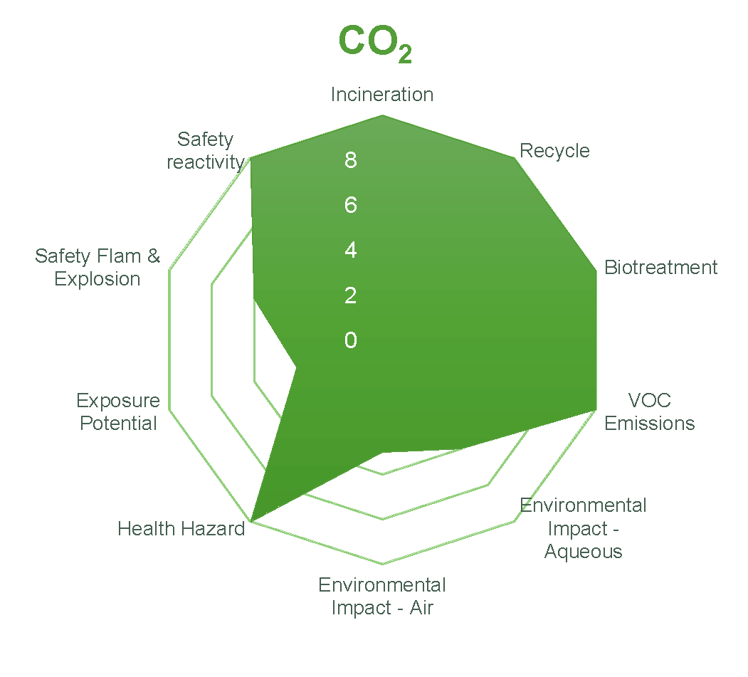

GSK solvent sustainability guide
Safety
Waste
C. West, The Green Analytical Chemistry Workshop, Feb. 2nd, 2026
Health
Best in class?
Environment
‹#›
Based on a kind communication from Dr. H. Sneddon

Slide 19
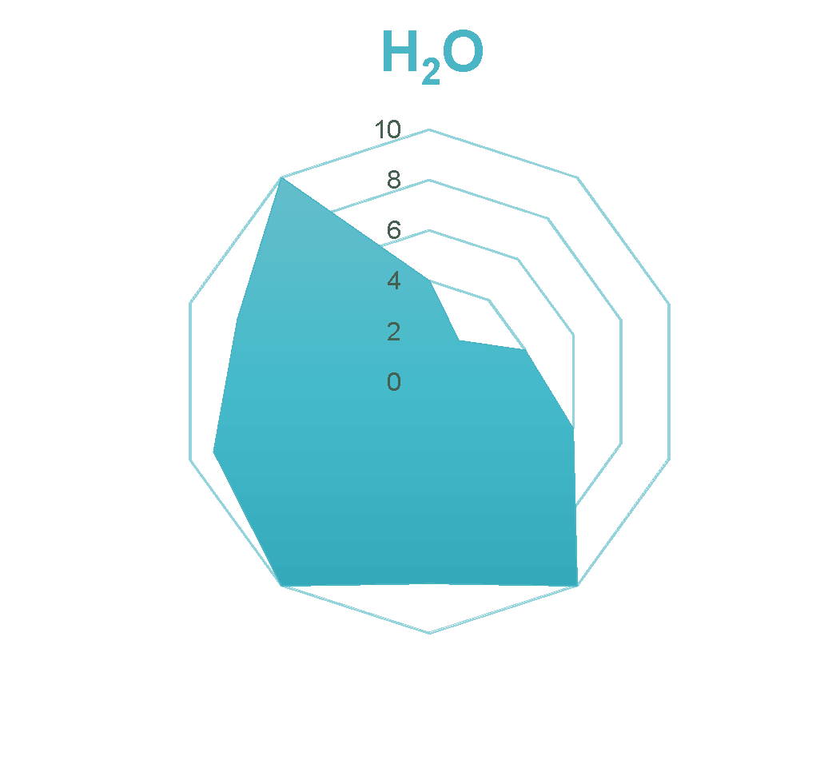
GSK solvent sustainability guide
Safety
Waste
C. West, The Green Analytical Chemistry Workshop, Feb. 2nd, 2026
Health
Environment
‹#›
C.M. Alder et al., Green Chem. 18 (2016) 3879 and based on a kind communication from H. Sneddon

Slide 20

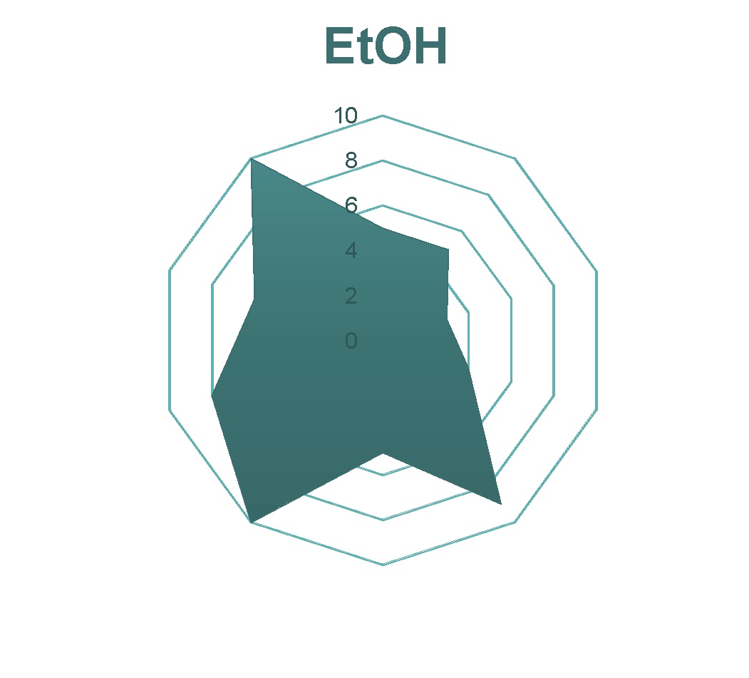
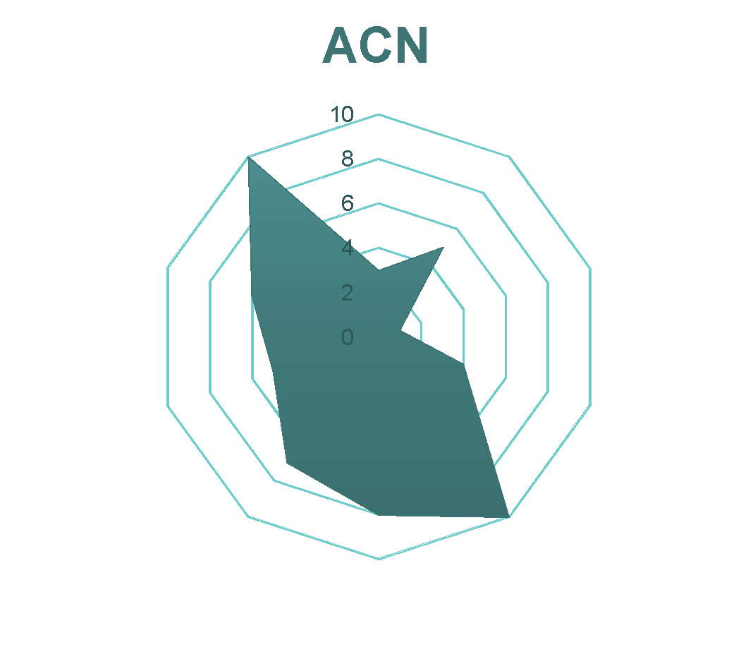
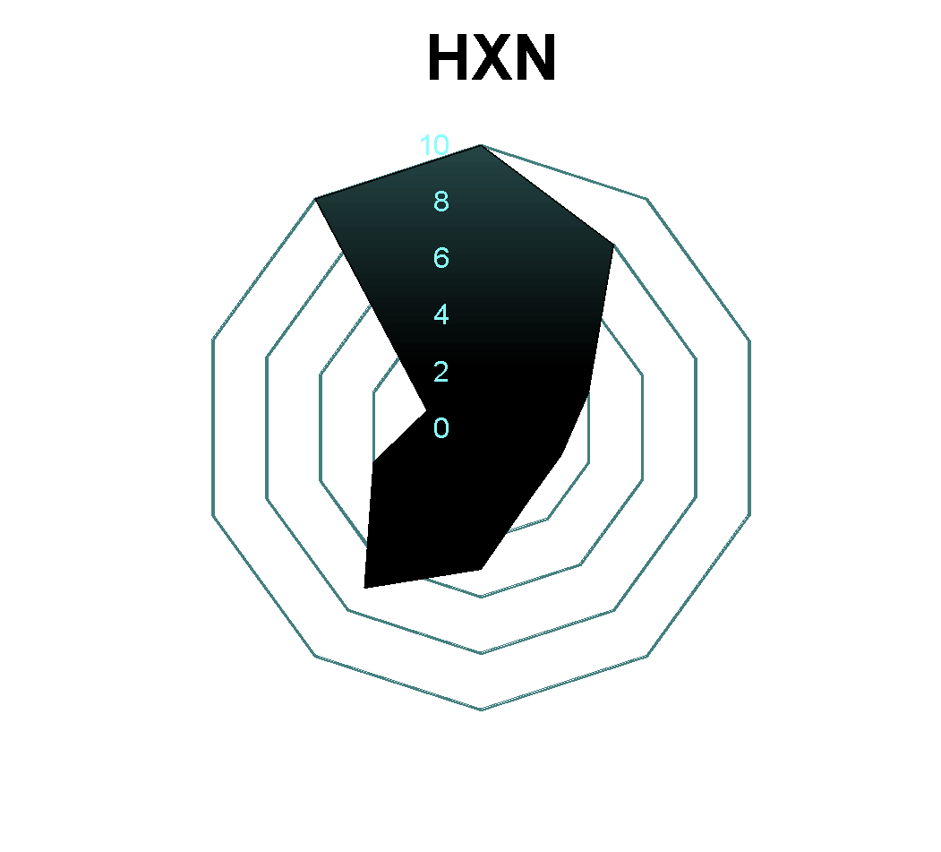
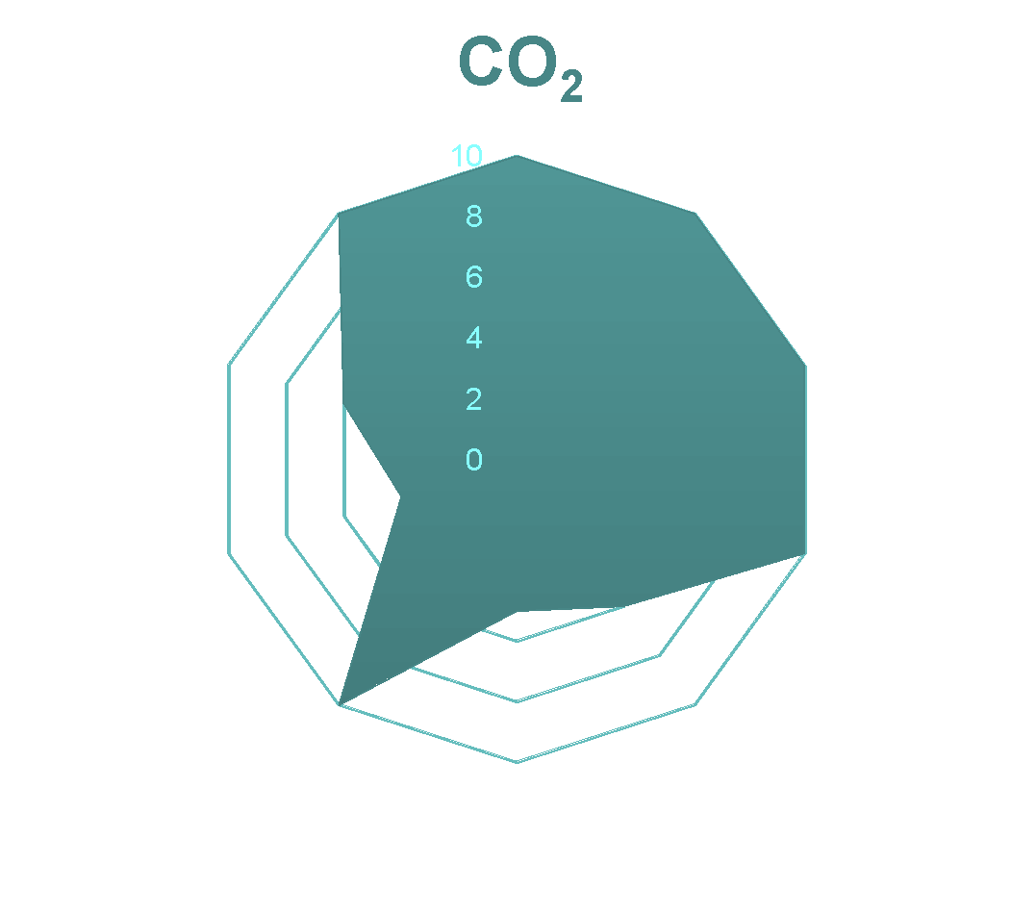
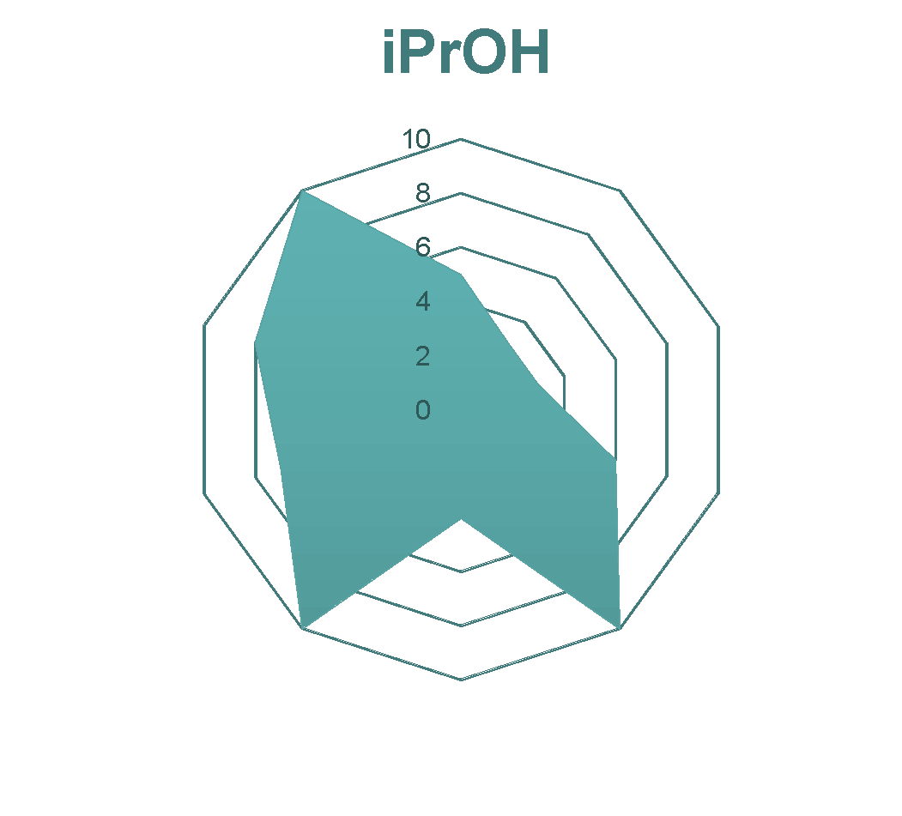
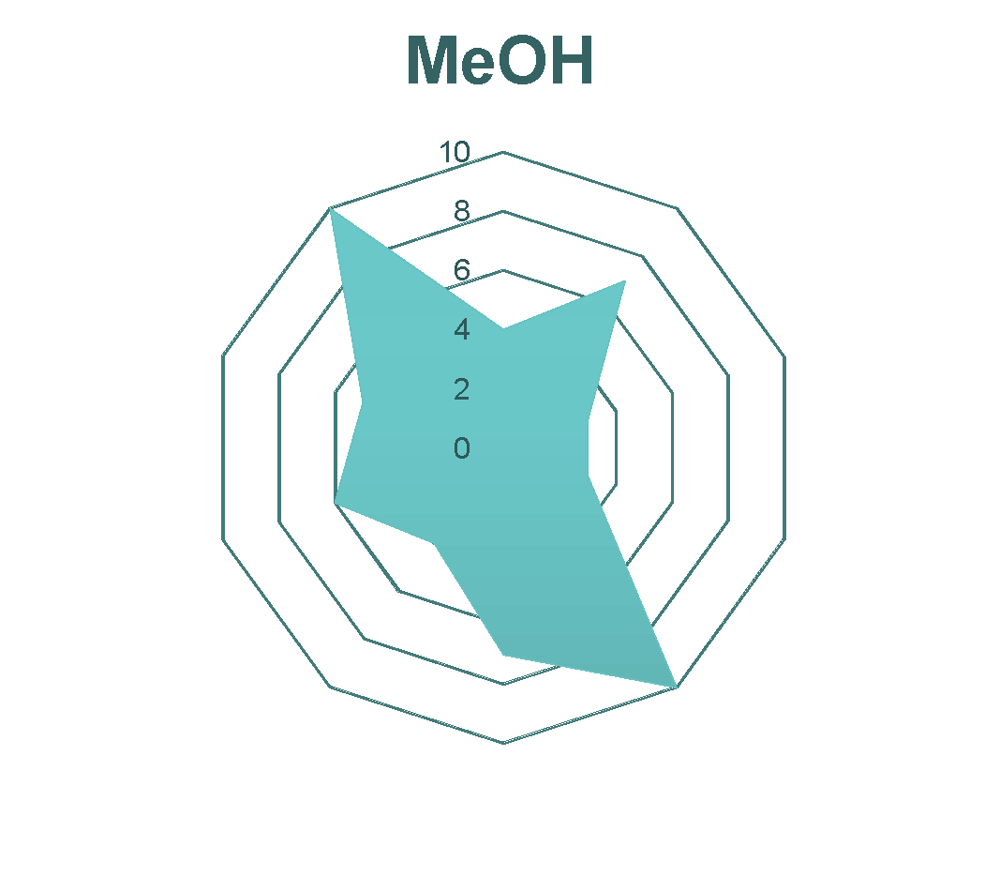
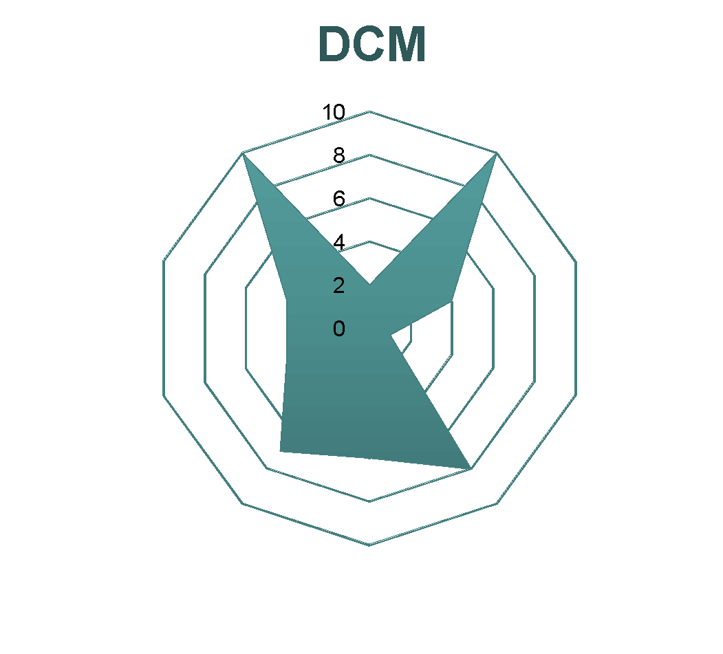
GSK solvent sustainability guide
C. West, The Green Analytical Chemistry Workshop, Feb. 2nd, 2026
‹#›
C.M. Alder et al., Green Chem. 18 (2016) 3879 and based on a kind communication from H. Sneddon

Slide 21



GSK solvent sustainability guide
C. West, The Green Analytical Chemistry Workshop, Feb. 2nd, 2026
‹#›
C.M. Alder et al., Green Chem. 18 (2016) 3879 and based on a kind communication from H. Sneddon

Slide 22
Greener processes
with online SFE-SFC

Slide 23
SFE-SFC Instrument
Oven
Column
oven
Make-up
fluid
CO₂
pump
Loop
interface
MS
UV or DAD
CO₂
Solvent
pump
Packed
columns
C. West, The Green Analytical Chemistry Workshop, Feb. 2nd, 2026
Extraction
cells
BPR
BPR
Fraction collection or waste
Co-solvent
A « natural » association
Kinetic studies of extraction
On-line analysis/purification of extracts
Fraction
collection
‹#›

Slide 24

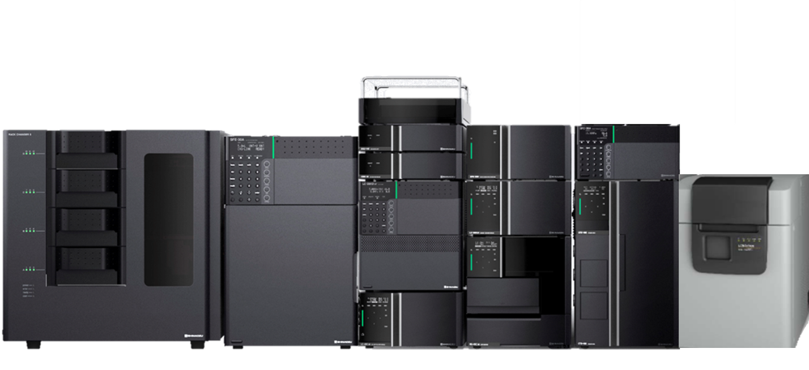
Nexera UC SFE-SFC-MS system
C. West, The Green Analytical Chemistry Workshop, Feb. 2nd, 2026
‹#›

Slide 25
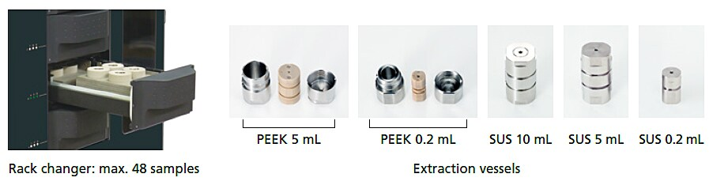
Nexera UC SFE-SFC-MS system
C. West, The Green Analytical Chemistry Workshop, Feb. 2nd, 2026
‹#›

Slide 26
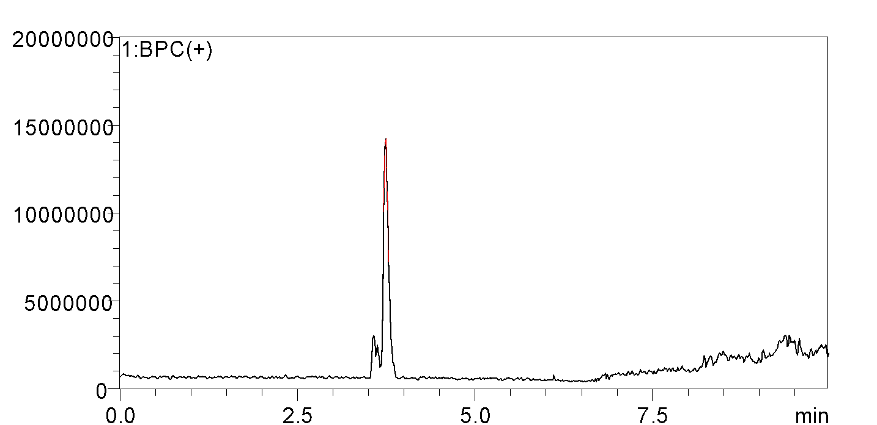
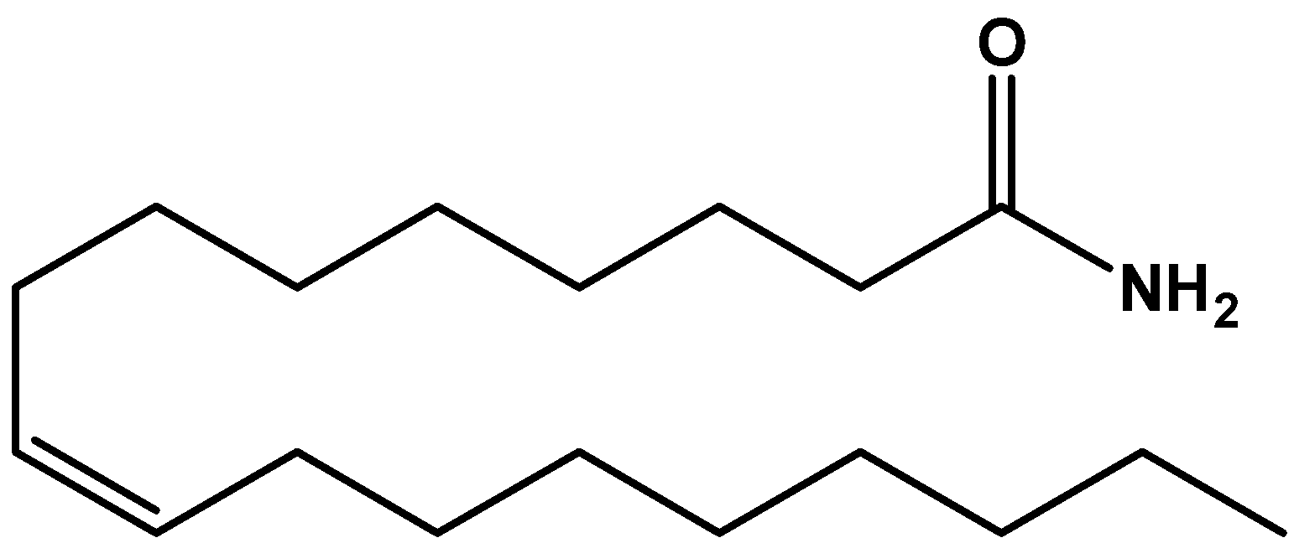
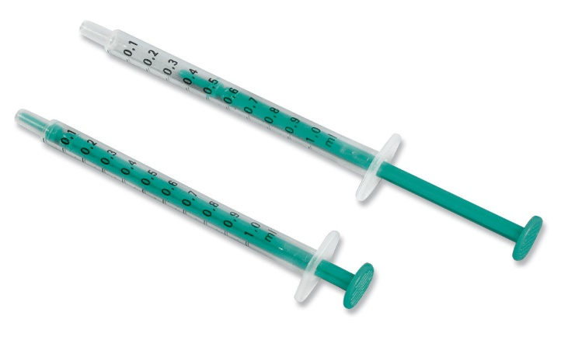
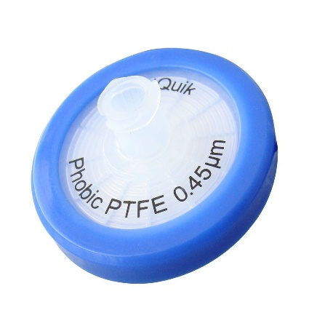
Problems with off-line extraction
Plastic waste +
sample contamination
Oleamide
(lubricant)
Plastic syringe and filter
C. West, The Green Analytical Chemistry Workshop, Feb. 2nd, 2026
‹#›
B. Caux et al., J. Chromatogr. A, 1735 (2024) 465323

Slide 27
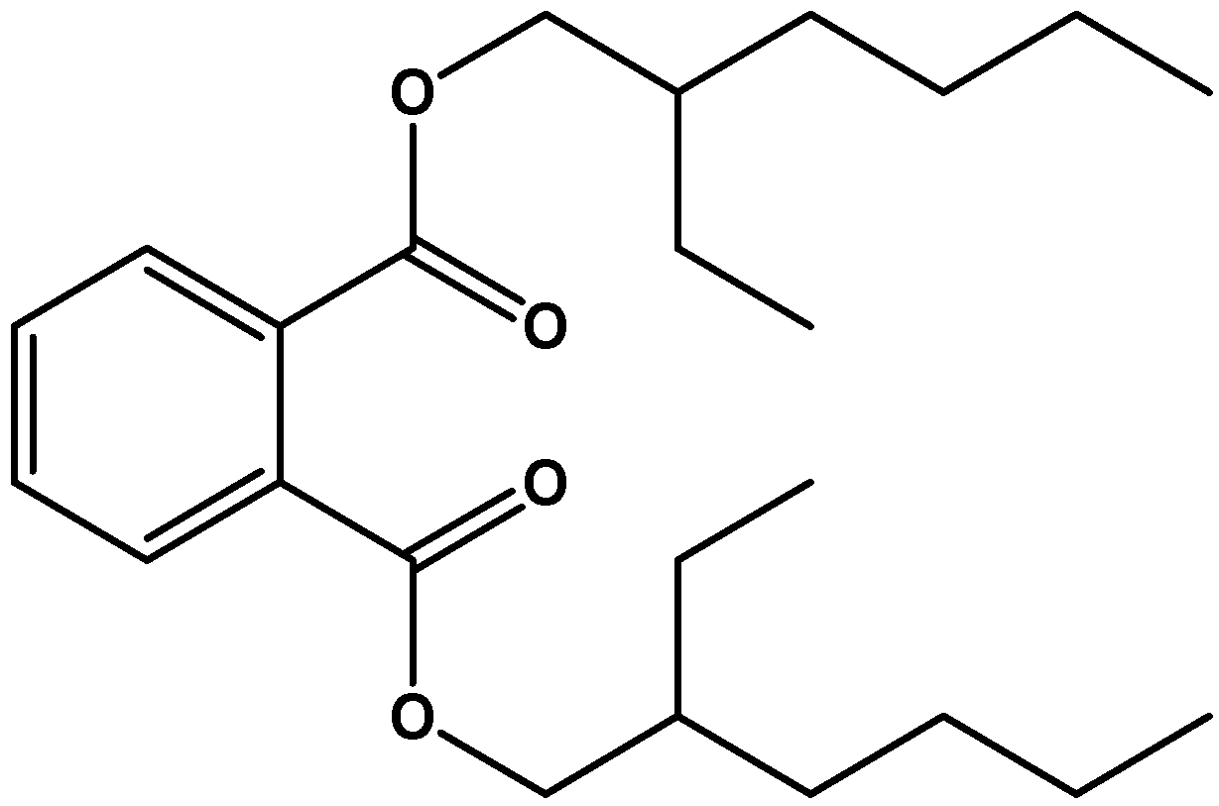
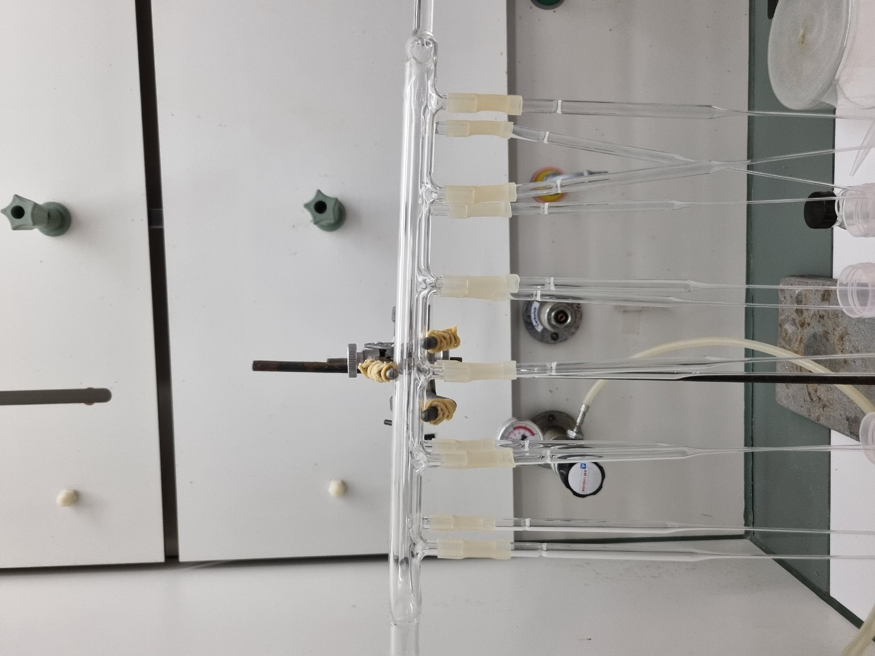
Problems with off-line extraction
Flexible plastic tubings
sample contamination
DEHP
(plasticizer)
C. West, The Green Analytical Chemistry Workshop, Feb. 2nd, 2026
N₂ drying
Air drying
CO₂ flushing
‹#›
B. Caux et al., J. Chromatogr. A, 1735 (2024) 465323

Slide 28
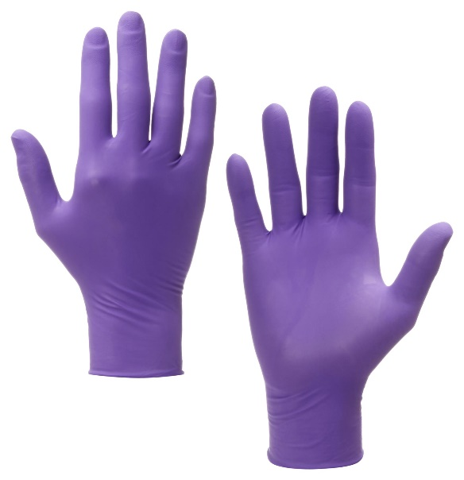
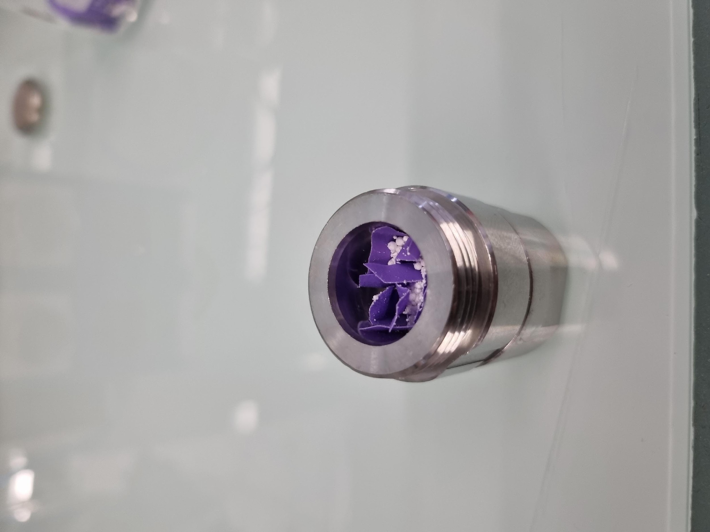
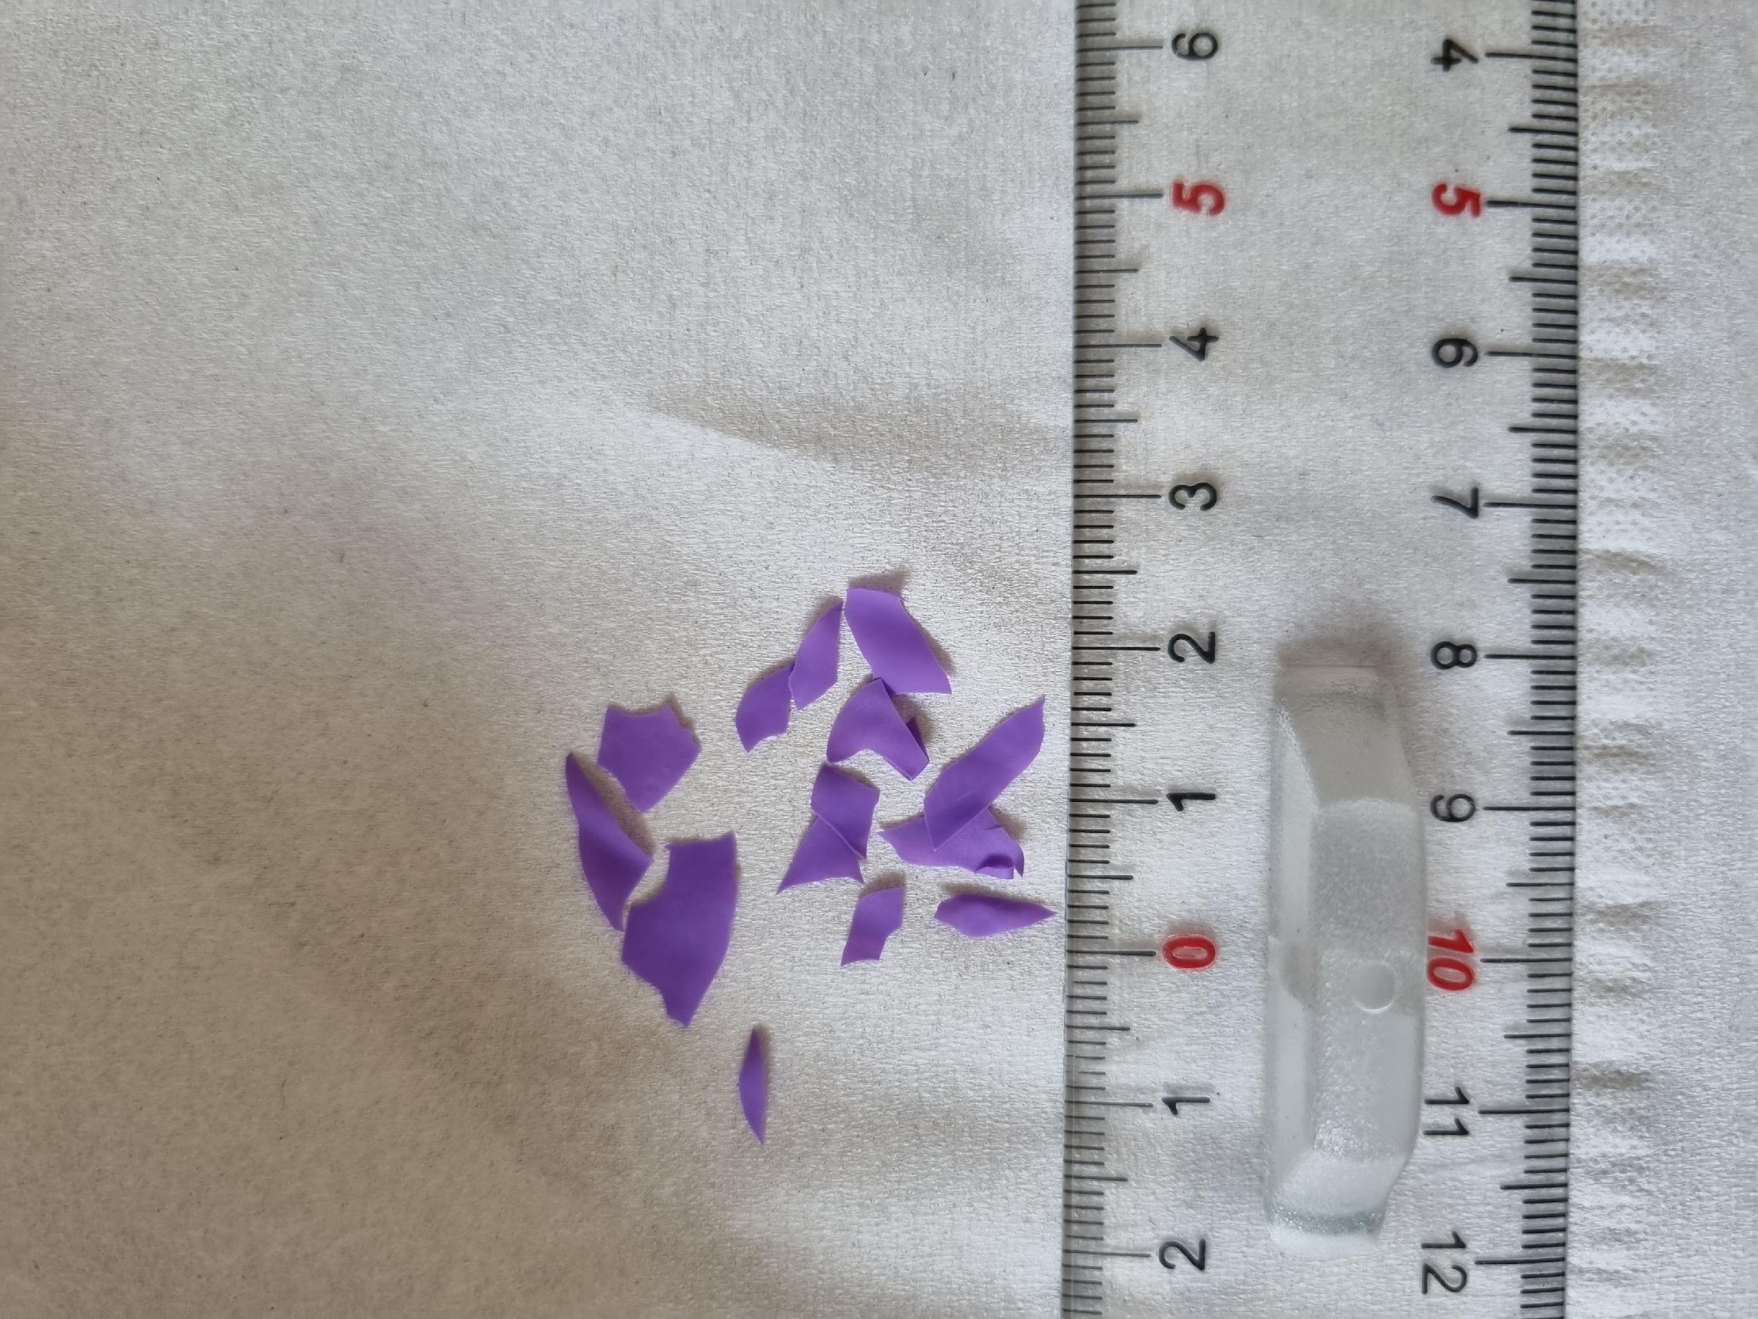
Avoid lab contaminants and plastic waste
with online SFE-SFC-MS
SFE-SFC-MS of nitrile gloves
Looking for plastic additives
Add beads
(dehydrating agent)
C. West, The Green Analytical Chemistry Workshop, Feb. 2nd, 2026
Cut in pieces
Online
SFE-SFC-MS
1 g sample
‹#›
B. Caux et al., J. Chromatogr. A, 1735 (2024) 465323

Slide 29

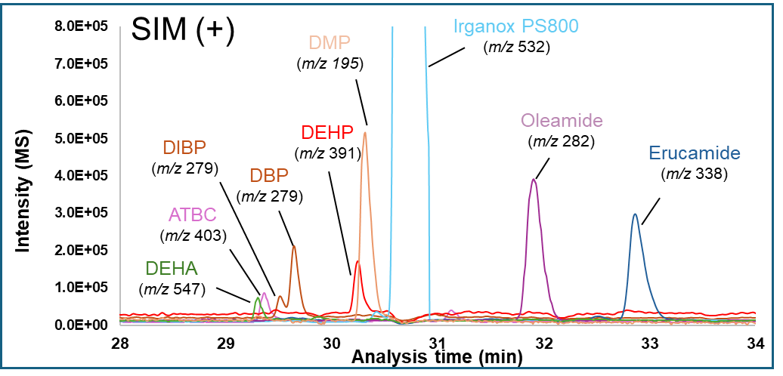
Avoid lab contaminants and plastic waste
with online SFE-SFC-MS
SFE-SFC-MS of nitrile gloves
Looking for plastic additives
C. West, The Green Analytical Chemistry Workshop, Feb. 2nd, 2026
‹#›
B. Caux et al., J. Chromatogr. A, 1735 (2024) 465323

Slide 30
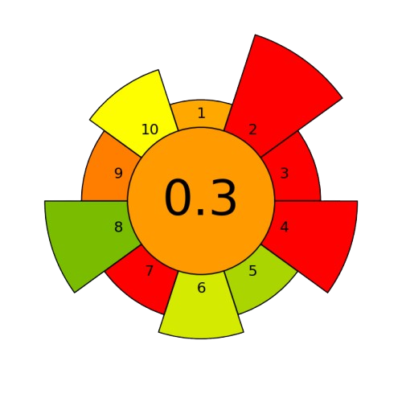
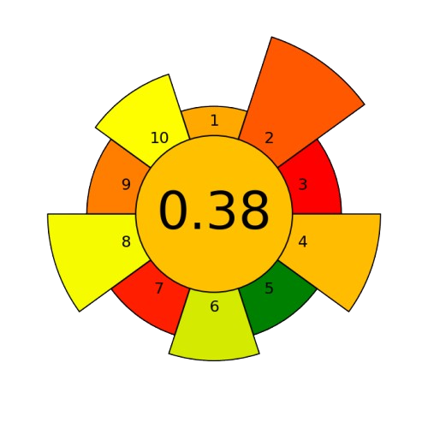
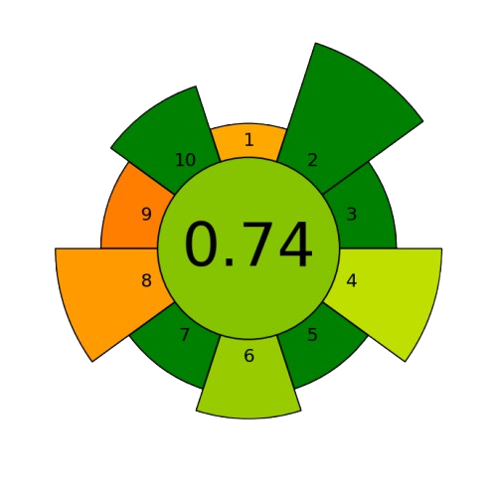
A greener method
AGREEprep Greenscore
Safe for operator
Non-toxic
Reusable
vessel
C. West, The Green Analytical Chemistry Workshop, Feb. 2nd, 2026
Energy consumption
Online
system
Dissolution precipitation
Ultrasound extraction
Online SFE
Gimeno et al., J Chromatogr B, 949-950, 2014, 99-108
Poitou et al., Toxics, 9, 2021, 200
Caux et al., J Chromatogr A, 1735, 2024, 465323
‹#›
Wojnowski et al., Trends in Anal. Chem., 149, 2022, 116553

Slide 31


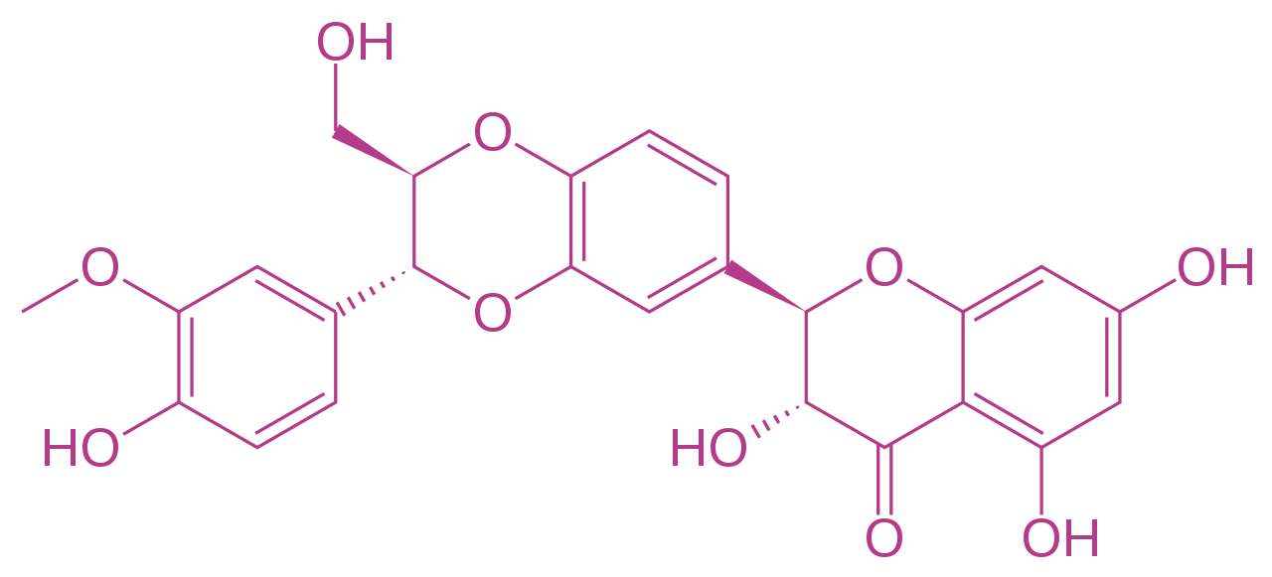
Complex samples (apolar/polar)
Seeds of
Milk thistle
Silibinine
(Flavonolignans)
Triglycerides
C. West, The Green Analytical Chemistry Workshop, Feb. 2nd, 2026
Usual way to deal with such sample complexity is
to extract the plant material with general-purpose solvent
then LLE or prep-LC to purify fractions
Involves large quantities of solvent and energy
‹#›

Slide 32
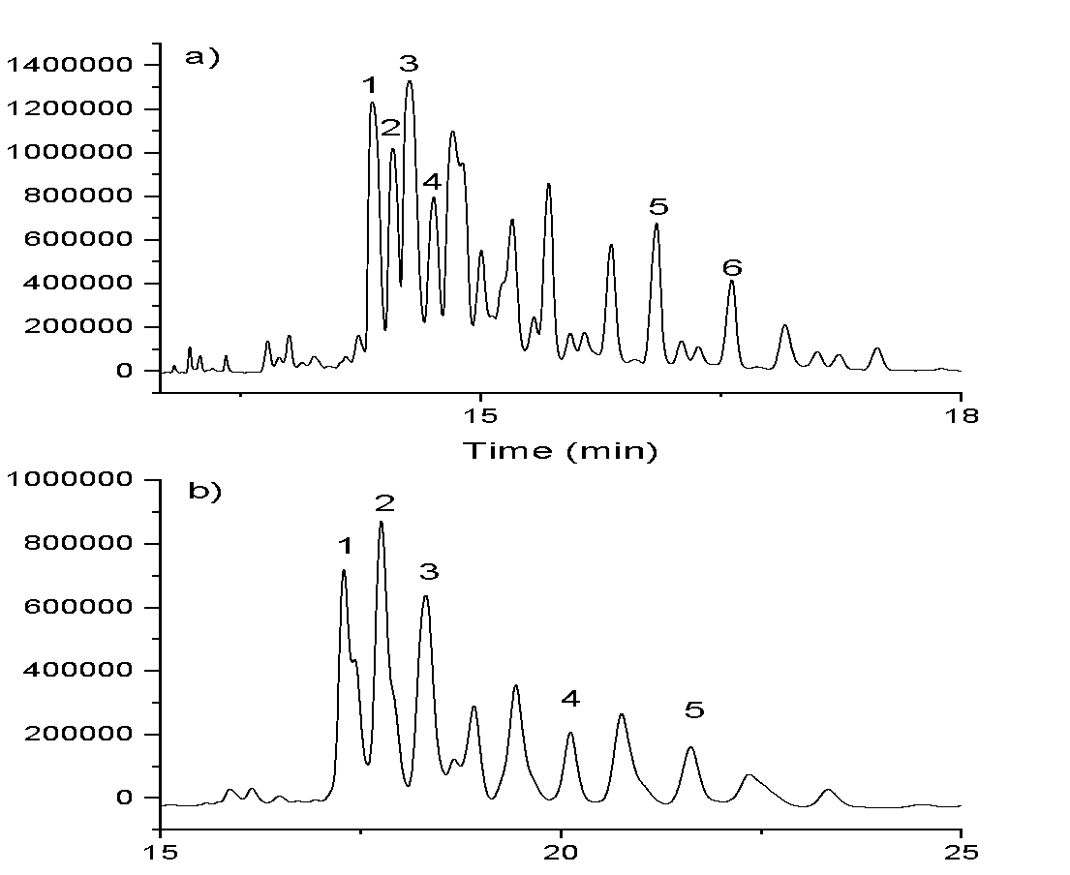
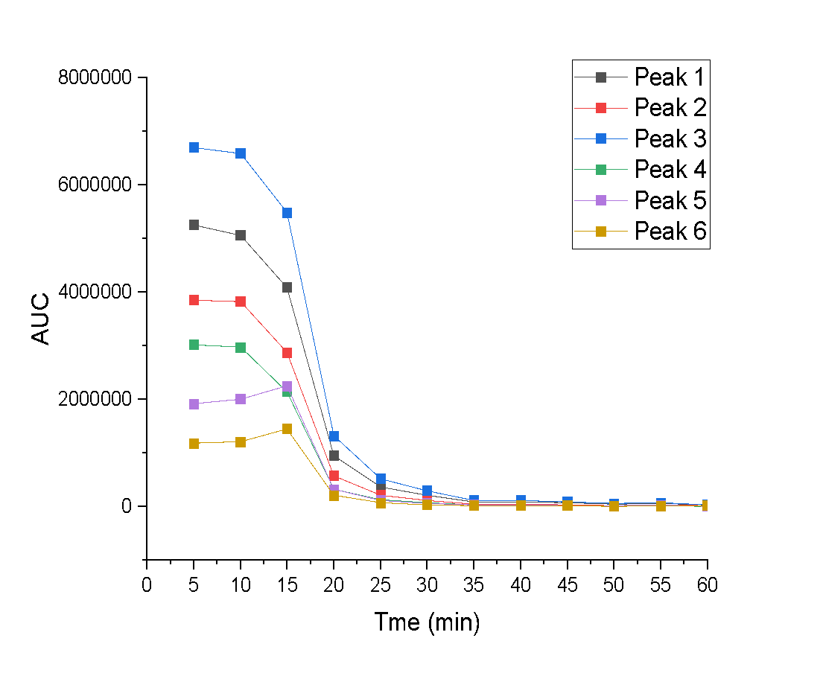
Complex samples (apolar/polar)
Seeds of
Milk thistle
Silibinine
(Flavonolignans)
Triglycerides
C. West, The Green Analytical Chemistry Workshop, Feb. 2nd, 2026
Step 1 :
Delipidation of seeds
100% CO₂
40°C, 3 mL/min
249 bar / 250 bar
No more lipids
Kinetics with quick, low-resolution online SFC-MS
(every 5 min)
Q. Gros et al., J. Chromatogr. A 1705 (2023) 464168
‹#›

Slide 33
Complex samples (apolar/polar)
Seeds of
Milk thistle
Silibinine
(Flavonolignans)
Triglycerides
Sequential selective extraction (S³FE)
C. West, The Green Analytical Chemistry Workshop, Feb. 2nd, 2026
Step 1 :
Delipidation of seeds
100% CO₂
30 min, 40°C, 3 mL/min
249 bar / 250 bar
Step 2 :
Extraction of polyphenols
CO₂-EtOH 70-30
40°C, 3 mL/min
249 bar / 250 bar
Q. Gros et al., J. Chromatogr. A 1705 (2023) 464168
‹#›

Slide 34
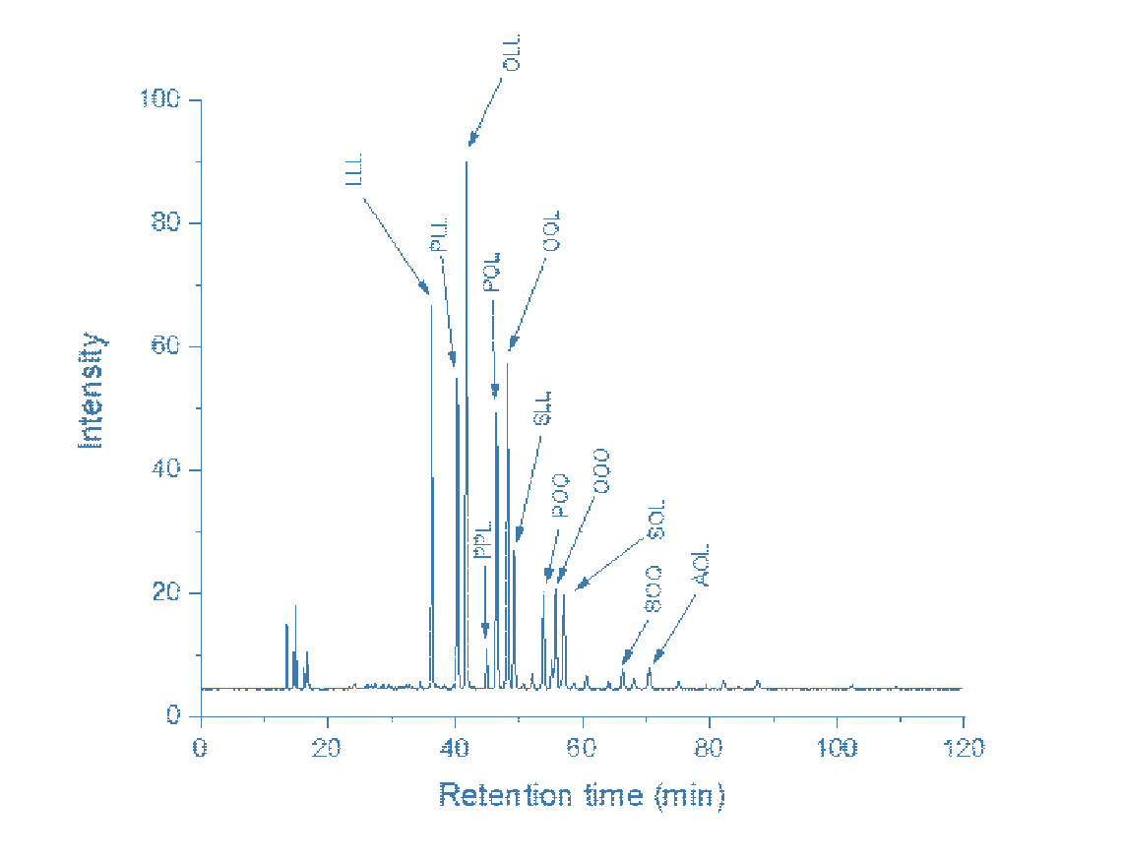
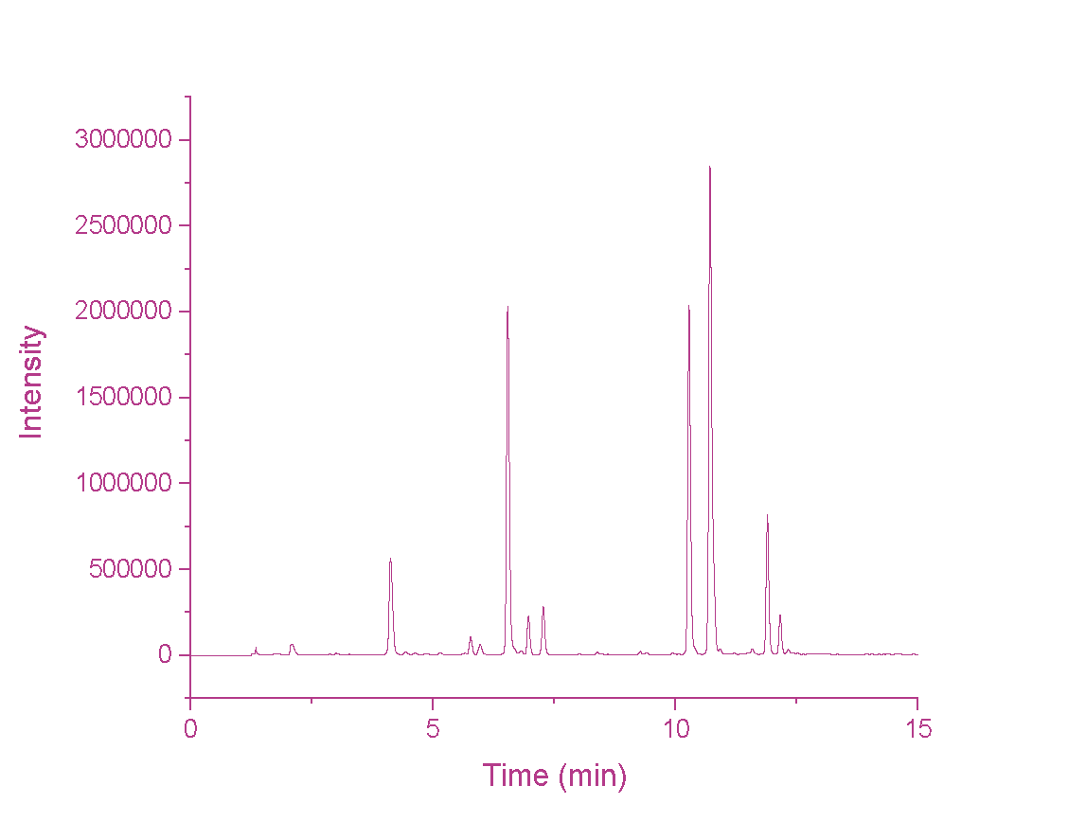
Complex samples (apolar/polar)
SFE with pure CO₂
SFC-MS of lipids
SFE with CO₂-EtOH
SFC-MS of polyphenols
Seeds of
Milk thistle
S³FE-SFC: extract and analyze all in a single experiment
Triglycerides
Silibinine
(Flavonolignans)
C. West, The Green Analytical Chemistry Workshop, Feb. 2nd, 2026
Q. Gros et al., J. Chromatogr. A 1705 (2023) 464168
‹#›

Slide 35
Take home
SFC is usually faster than LC at comparable scales:
translates into liquid solvent economy and energy economy
Usual solvents in SFC are among the most desirable (EtOH > MeOH!)
On-line SFE-SFC is great to:
Simplify sample preparation
Reduce solvent consumption
Reduce plastic waste
Avoid lab contaminations for trace analysis
Observe the full sample in a single experiment with S³FE
Purify target compounds online with SFE
C. West, The Green Analytical Chemistry Workshop, Feb. 2nd, 2026
‹#›

Slide 36





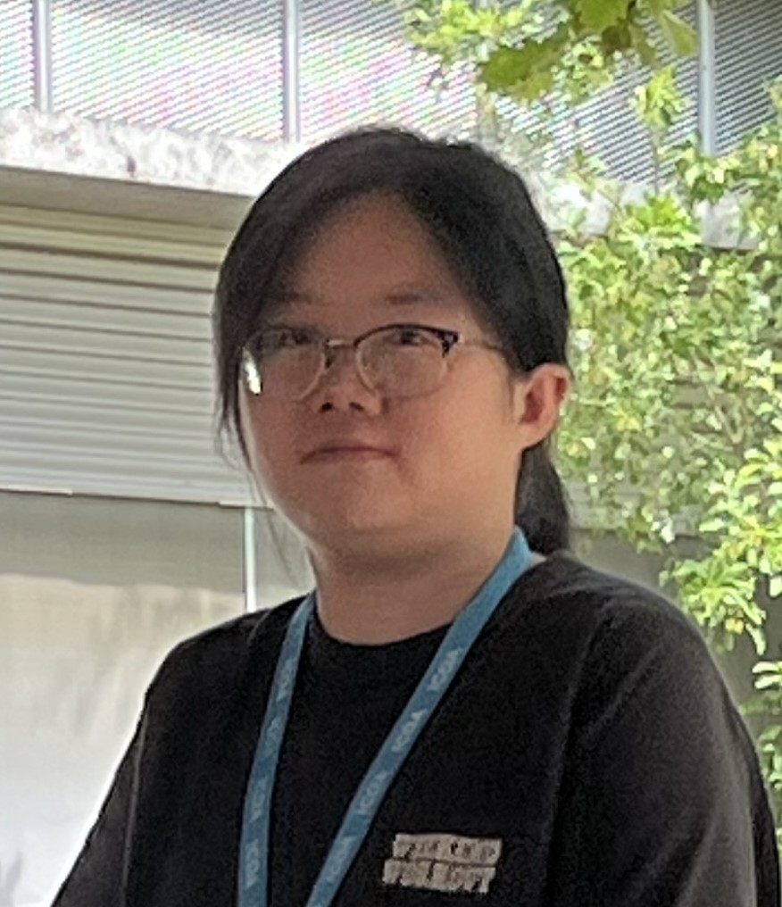

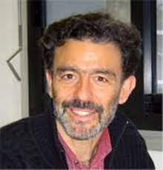

SŌSHI Center
Dr. Clément
De Saint Jores
Thanks !
Yiting
Zhou
Dr. Benjamin
Caux
Dr. Eric Lesellier
Y. Fujito, Dr. Quentin Gros,
R. Abou-Naccoul, S. Horie

